Slide 1

The Perception of ChatGPT in Learning Basic Python Coding
Michael A. Larbi
May 3rd, 2023

Slide 2



Overview
Introduction
Materials & Methods
Results
Summary
Limitations & Future Work
Git Hub Link
Questions

Slide 3



Introduction
How I came across this topic?
What are Intelligent Tutoring Systems (ITSs)
What is the importance?
Why did I pick this topic?
Wednesday, May 3rd , 2023

Slide 4

Introduction(Background)
What are intelligent Tutoring Systems ?
Intelligent Tutoring Systems (ITS) is an aspect of Artificial Intelligence (AI) in education. It is a computerized tutoring system or program that provides student-specific instructions based on their personal learning needs and progress. It is a field of computer science and engineering that aims to create intelligent machines that mimic the role of a human tutor, providing feedback, guidance, and support to help improve students’ success.
Wednesday, May 3rd , 2023

Slide 5
Introduction(Background)
What are intelligent Tutoring Systems ?
ITSs are computer programs that aim to provide immediate and personalized feedback to learners, usually without the need for human intervention. By using machine learning algorithms, natural language processing, and other AI techniques, ITSs can analyze a student's learning needs and create a personalized lesson plan based on their individual strengths and weaknesses.
Wednesday, May 3rd , 2023

Slide 6
Introduction(Background)
The radix of ITSs can be trailed back from the 1960s through the ‘70s with some of its earliest inventions being “Seymour Papert’s Logo”.with further development of the “ACT” systems and Intelligent Computer-Assisted Leaning (ICAI) in the 1970s and ’80s, now known as ITSs, helped diagnose student errors, provide progress feedback as well as teaching math.
Wednesday, May 3rd , 2023

Slide 7
Introduction(Background)
Over the past few years, Intelligent Tutoring Systems (ITSs) have gained a great deal of attention in the field of education. It has been shown in numerous studies that intelligent tutoring systems like GhatGPT can greatly enhance students' learning outcomes, especially in difficult and time-consuming subjects, similarly w3schools provides the platform for learning coding in its simplicity.
Wednesday, May 3rd , 2023

Slide 8
Introduction(Background)
What are ChatGPT and w3schools ?
Wednesday, May 3rd , 2023

Slide 9
Introduction(Background)
ChatGPT is a large language model or a chatbot system developed by Open AI and was released in November 2022, based on GPT -3.5 and GPT -4 architecture model, trained to understand and generate human-like text, as well as to perform a wide range of natural language processing tasks. In computer science ChatGPT is a very useful toolkit for developers in areas like :
debugging,
code optimization
Snippet prediction
refactoring etc.
Wednesday, May 3rd , 2023

Slide 10
Introduction(Background)
Similarly, W3schools.com (an educational website launched in 1998), provides the “teach yourself tutorials”, references on topics and “when as needed” platform for learning programming in its simplicity. This website has embedded technology to help you run sample code to better help you understand each syntax, programming subject topic and sub-topics and delivers real-time feedback.
Wednesday, May 3rd , 2023

Slide 11
Introduction (Significance)
To deepen our understanding about students’ perception on the use of ChatGPT to learn basic python coding.
Wednesday, May 3rd , 2023

Slide 12
Introduction(Objective)
To examine the experiences of students with ChatGPT in learning basic python coding
To examine the experiences of students with w3schools in learning basic python coding
Aims to compare the learning experience of senior computer science students in using w3schools and chatGPT to learn basic python programming at Eastern Connecticut State University
Hypothesis:
That ChatGPT will be more informative and have more preference than w3schools.
Wednesday, May 3rd , 2023

Slide 13
Materials and Methods
Research and Review Articles
Laptop
SurveyMonkey
10 undergrad students from 2023 Spring Senior Research class
David G. Carter (Sci. Building) classroom 135
Piazza.com
Classroom desktop computers
Google flip a coin
Microsoft word
W3schools.com (website)
Wednesday, May 3rd , 2023

Slide 14
Materials and Methods
Explored the students’ perception of chatGPT in learning basic coding using surveyMonkey by examining:
Participants prior experience in python
Paticipants prior experience with ChatGPT and w3schools
How much they learn between ChatGPT and w3school
Participants overall preference between ChatGPT and w3schools.
Conduct a comparative analysis for better understanding between ChatGPT and w3schools
Represent the results Bar chart and pie chart
Wednesday, May 3rd , 2023

Slide 15
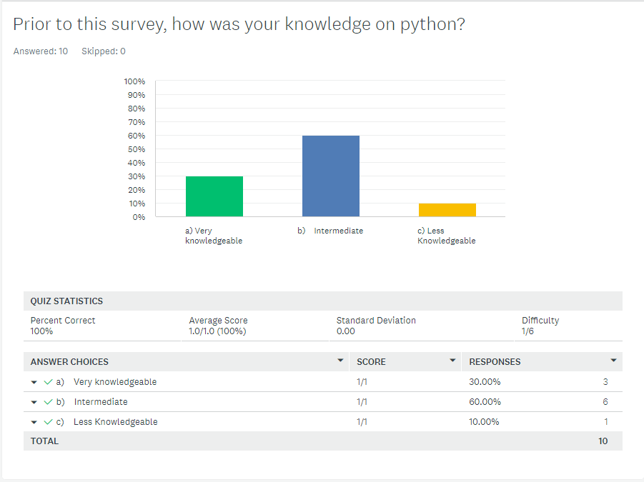
Results
Here 90% of the participants indicated that they had prior knowledge of python with 30% being very knowledgeable with python
Wednesday, May 3rd , 2023

Slide 16
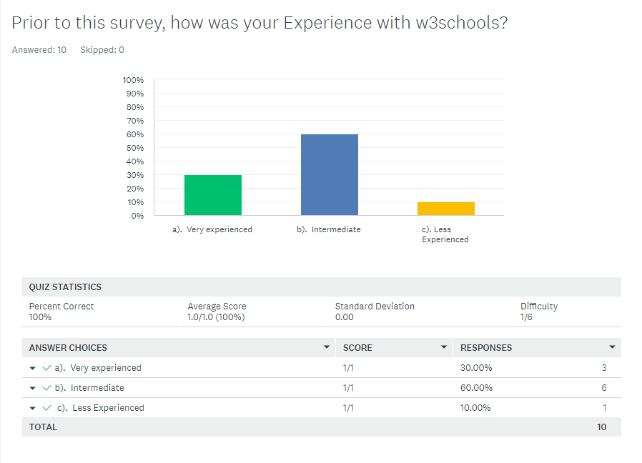
Results
Here 30% of the participants indicated that they were very experienced with w3schools as opposed to 10% who less experienced with 60% being intermediate prior to the survey.
Wednesday, May 3rd , 2023

Slide 17
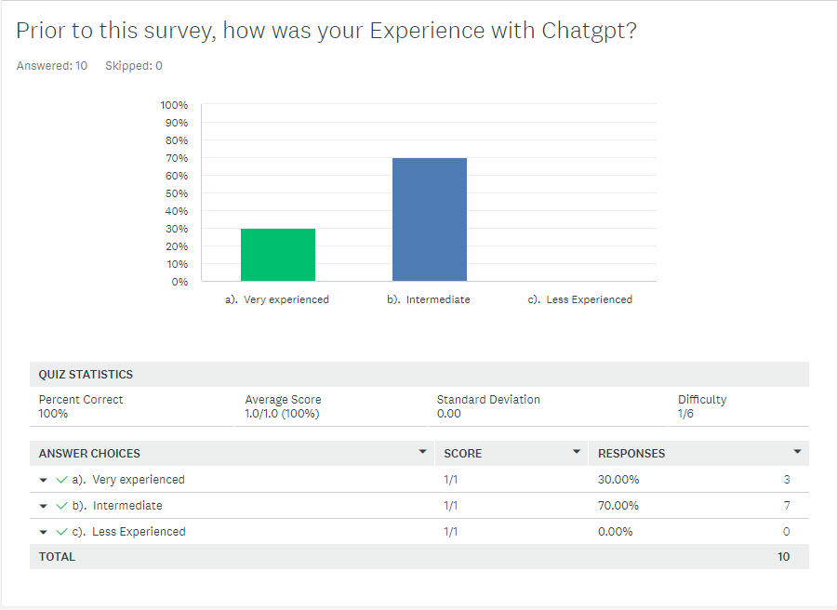
Results
Here 30% of the participants indicated that they were very experienced with ChatGPT as opposed to 70% who were intermediately experienced with none being less experienced prior to the survey.
Wednesday, May 3rd , 2023

Slide 18
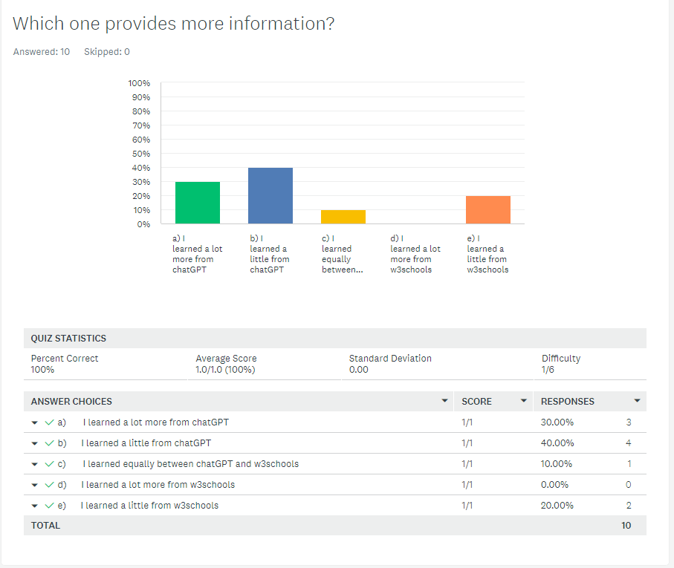
Results
Here 30% of the participants indicated ChatGPT was a lot more informative than w3schools prior to the survey.
Overall ChatGPT was 70% informative than w3schools.
Wednesday, May 3rd , 2023

Slide 19
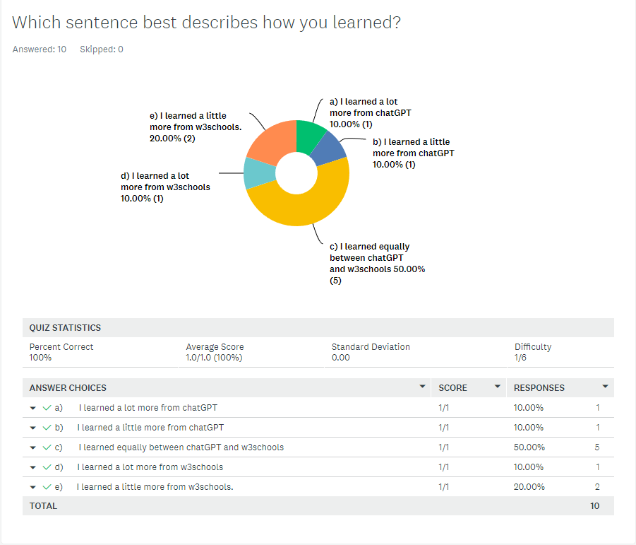
Results
Fifty five percent (55%) participants specified that they learnt more with w3schools than forty five percent (45%) for ChatGPT after the survey.
Wednesday, May 3rd , 2023

Slide 20
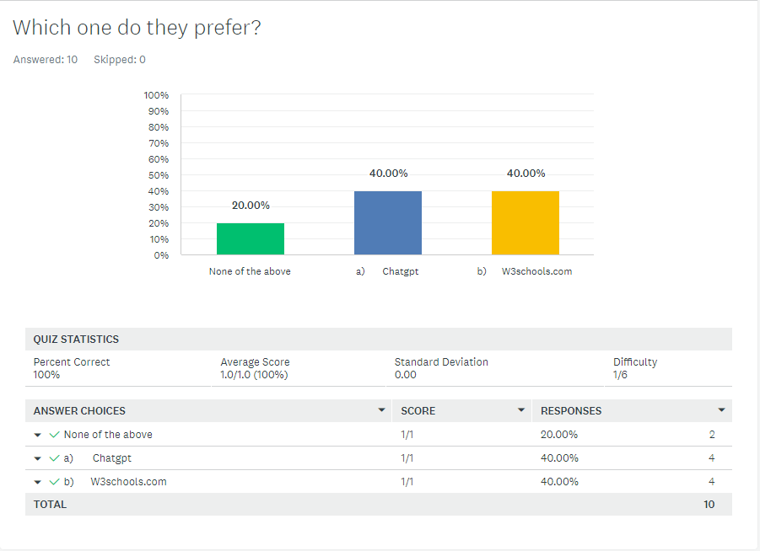
Results
Overall Eighty percent (80%) preferred equally between ChatGPT and w3schools where as, twenty percent preferred none.
Wednesday, May 3rd , 2023

Slide 21
Summary
Wednesday, May 3rd , 2023

Slide 22

Summary
ChatGPT was more informative than w3schools
Participants were more experienced with ChatGPT than w3schools
Participants learnt more with w3schools than ChatGPT
There was equal preference between ChatGPT and w3schools.
Overall, participants equally preferred ChatGPT to w3school
Wednesday, May 3rd , 2023

Slide 23
Limitations & Future work
Limitations:
Did not include randomly selected student participants.
Was based on basic python coding not intermediate or expert level python coding
Did not include other programming languages
Was only based on results between ChatGPT and w3schools only.
Time constraint
Limited number of participants
Wednesday, May 3rd , 2023

Slide 24
Limitations & Future work
Future work:
Apply random selection for student participants.
Intermediate or expert level python coding
Should include other programming languages
Compare ChatGPT to other Intelligent Tutoring Systems and educative platforms like w3schools.
Acquire enough time for in depth research study
Should include larger group of participants
Wednesday, May 3rd , 2023

Slide 25
Conclusion
Introduction
Materials & Methods
Results
Summary
Limitations & Future Work
Git Hub Link
Questions ?
Wednesday, May 3rd , 2023

Slide 26
Bibliography
[1] D. N. J. Ahuja and R. Sille, “A Critical Review of Development of Intelligent Tutoring Systems: Retrospect, Present and Prospect,” vol. 10, no. 4, 2013.
[2] M. J. Reiss, “The Use of Al in Education: Practicalities and Ethical Considerations,” Lond. Rev. Educ., vol. 19, no. 1, 2021, Accessed: Mar. 18, 2023. [Online]. Available: https://eric.ed.gov/?id=EJ1297682
[3] A. Jaiswal and C. J. Arun, “Potential of Artificial Intelligence for transformation of the education system in India”.
[4] X. Huang, D. Zou, G. Cheng, X. Chen, and H. Xie, “Trends, Research Issues and Applications of Artificial Intelligence in Language Education,” Educ. Technol. Soc., vol. 26, no. 1, pp. 112–131, 2023.
[5] A. C. Graesser, M. W. Conley, and A. Olney, “Running head: INTELLIGENT TUTORING SYSTEMS”.
[6] “Intelligent tutoring systems: an overview”.
[7] N. M. S. Surameery and M. Y. Shakor, “Use Chat GPT to Solve Programming Bugs,” Int. J. Inf. Technol. Comput. Eng. IJITC ISSN 2455-5290, vol. 3, no. 01, Art. no. 01, Jan. 2023, doi: 10.55529/ijitc.31.17.22.
[8] S. Biswas, “Role of ChatGPT in Computer Programming.: ChatGPT in Computer Programming.,” Mesopotamian J. Comput. Sci., vol. 2023, pp. 8–16, Feb. 2023, doi: 10.58496/MJCSC/2023/002.
[9] H. Chun, “A Study on the Impact of 3D Printing and Artificial Intelligence on Education and Learning Process,” Sci. Program., vol. 2021, p. e2247346, Nov. 2021, doi: 10.1155/2021/2247346.
[10] O. Omoyeni and S. Ojedeji, “Exploring the Potentials of Emerging Technologies for Literacy and Skills Development: Spotlight on Artificial Intelligence,” Int. J. Lit. Educ., Jan. 2019.
[11] S. Wang, H. Yu, X. Hu, and J. Li, “Participant or spectator? Comprehending the willingness of faculty to use intelligent tutoring systems in the artificial intelligence era,” Br. J. Educ. Technol., vol. 51, no. 5, pp. 1657–1673, Sep. 2020, doi: 10.1111/bjet.12998.
[12] “SurveyMonkey Analyze - Comparing Chatgpt with w3schools.” https://www.surveymonkey.com/analyze/browse/B2I0VaebSx5SXnbq6MF_2BiBhIU0UfvHM_2Br9T5rnH7nLA_3D? (accessed May 07, 2023).
[13] A. S. George and A. S. H. George, “A Review of ChatGPT AI’s Impact on Several Business Sectors,” Partn. Univers. Int. Innov. J., vol. 1, no. 1, Art. no. 1, Feb. 2023, doi: 10.5281/zenodo.7644359.
[14] M. Firat, How Chat GPT Can Transform Autodidactic Experiences and Open Education? 2023. doi: 10.31219/osf.io/9ge8m.
Wednesday, May 3rd , 2023

Slide 27
Git Hub Link
https://mikelarbi4u1.github.io/Michaels-ITSs-Project.com/
Wednesday, May 3rd , 2023

Slide 28


Thank You
Michael Larbi
larbim@my.easternct.edu
https://mikelarbi4u1.github.io/Michaels-ITSs-Project.com/
Wednesday, May 3rd , 2023

